Slide 1


TRC1902: Capillary Pressure Sensor Testing to Identify Curing Regimen in Freshly Placed Concrete Bridge Decks
Samuel Spann, Cameron D. Murray, Ph.D., Micah Hale, Ph.D., P.E.

Slide 2
Overview
Shrinkage in concrete
CPSS Explanation
Promoting shrinkage cracking
Current progress
Preliminary results
Future work

Slide 3
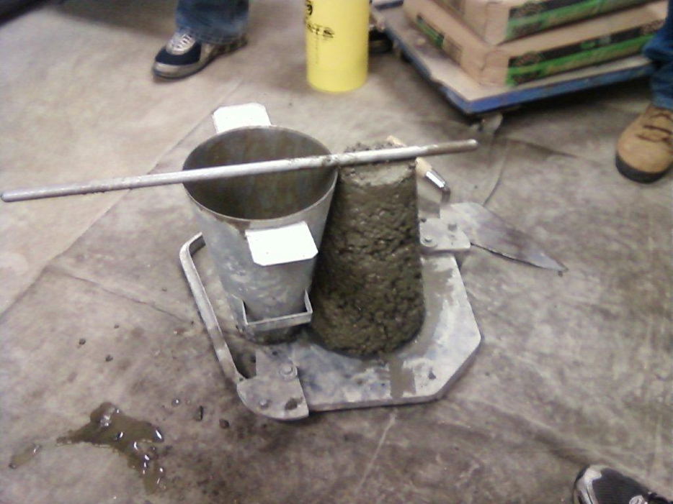
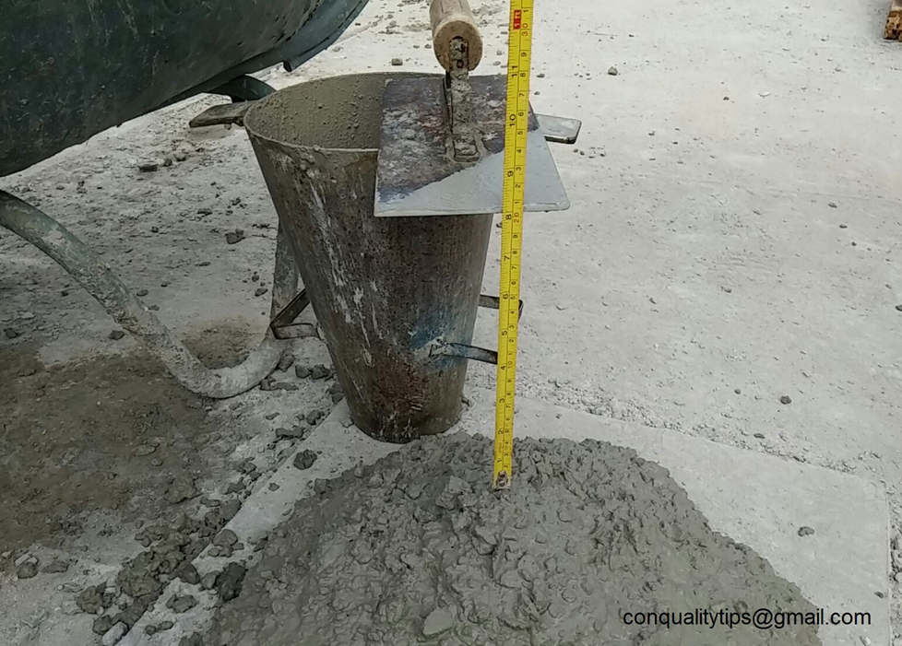
Shrinkage in concrete
Extra water is used in concrete mixtures (workability)

Slide 4
Shrinkage in concrete
When water leaves the concrete, shrinkage happens
Two main types of cracking:
  Plastic shrinkage (before concrete hardens)
  Drying shrinkage (after concrete hardens)

Slide 5
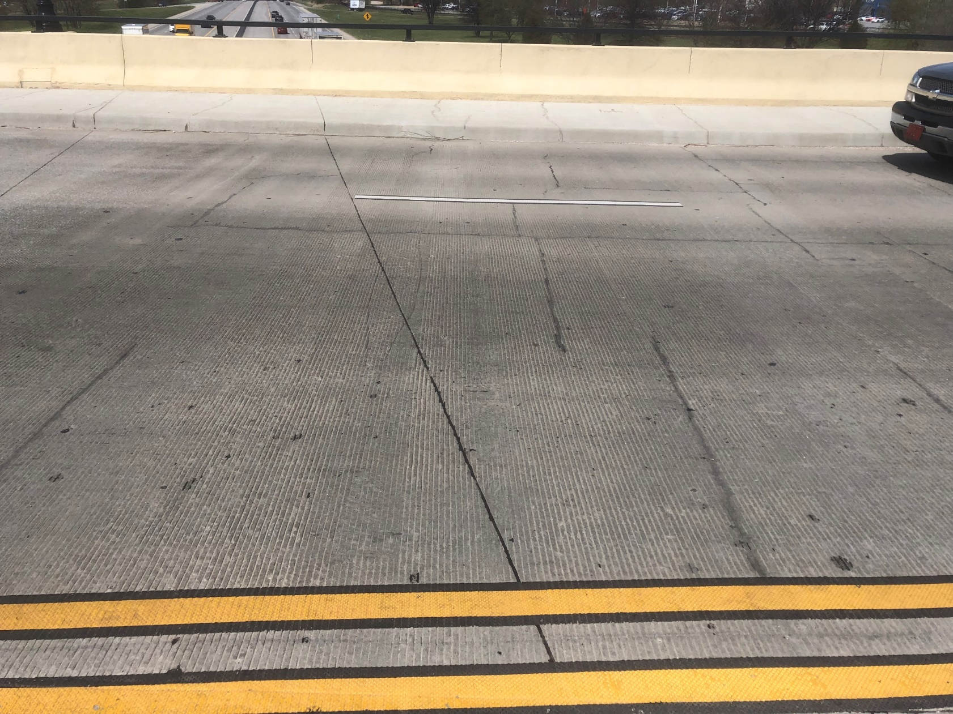
Shrinkage in concrete
Drying shrinkage
  Regular intervals
  Tend to be deep
Notes:
Elm springs road bridge over I49 in Springdale

Slide 6
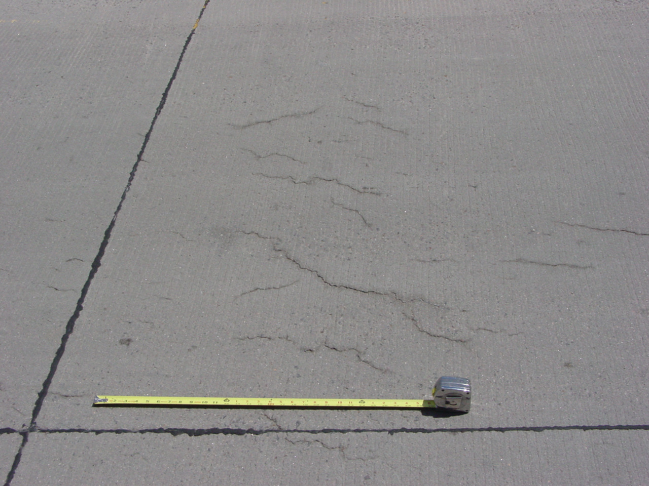
Shrinkage in concrete
Plastic shrinkage
  More cosmetic
  Shallow cracks
  Often random patterns
  Occurs before concrete hardens!
https://www.forconstructionpros.com/concrete/equipment-products/article/11487540/plastic-shrinkage-cracking

Slide 7

Plastic shrinkage
Caused by evaporation of bleed water
Bleed water

Slide 8
Plastic shrinkage
Rate of evaporation > bleed water rate = plastic shrinkage cracks

Slide 9
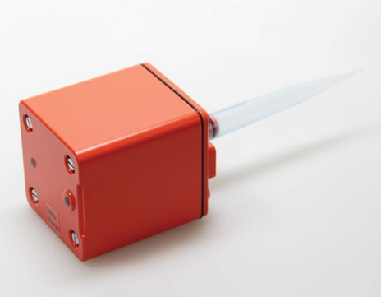
Capillary Pressure Sensor System (CPSS)
Evaporation leads to capillary pressure
  Builds up in concrete surface until the strength < stress
  We can measure these pressures

Slide 10
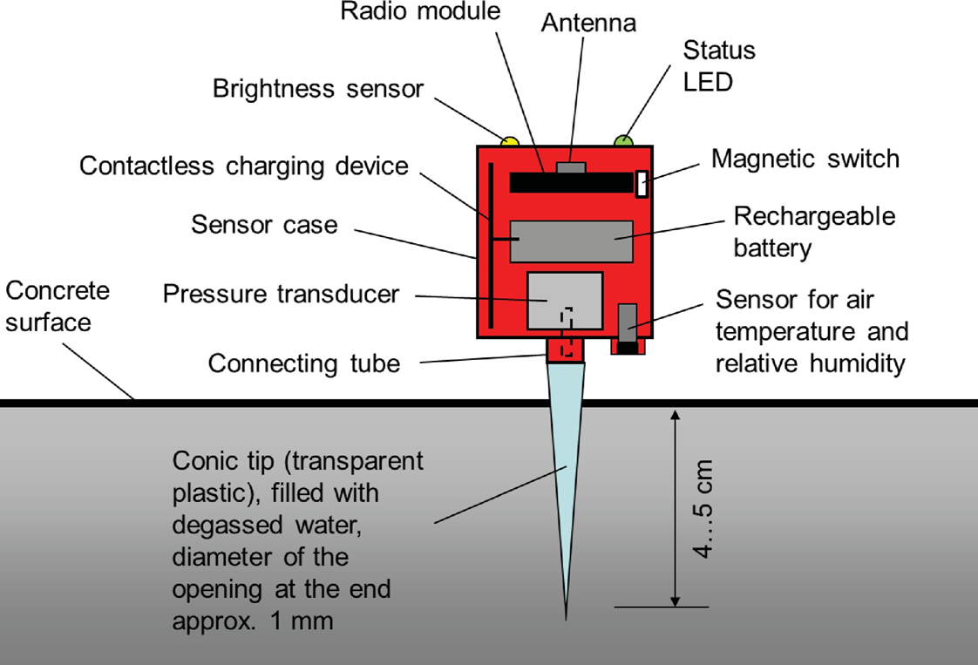
Capillary Pressure Sensor System (CPSS)

Slide 11
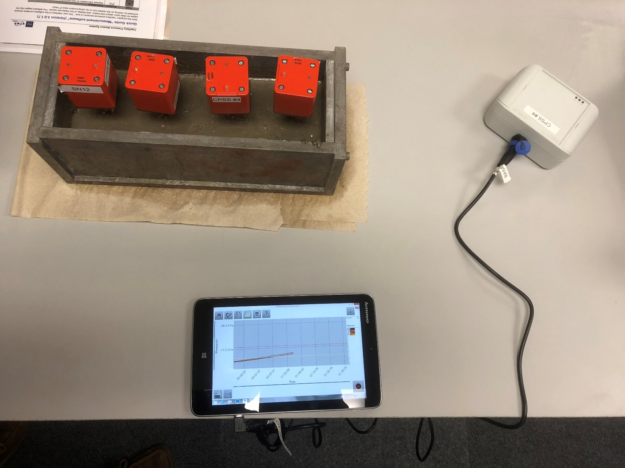
Capillary Pressure Sensor System (CPSS)

Slide 12
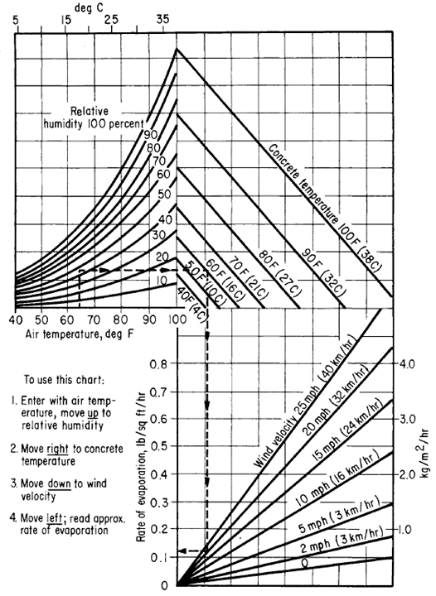
Promoting plastic shrinkage cracking
Increased air temperature
Increased concrete temperature
Increased wind speed
Lead to increased rate of evaporation

Slide 13
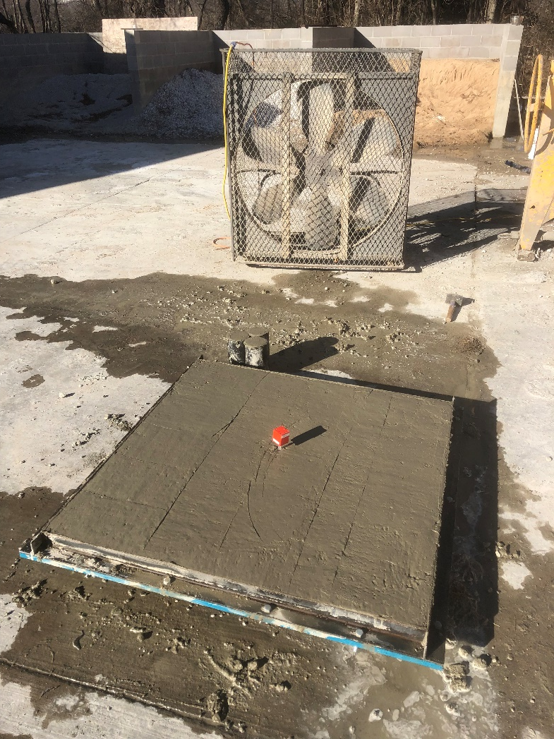
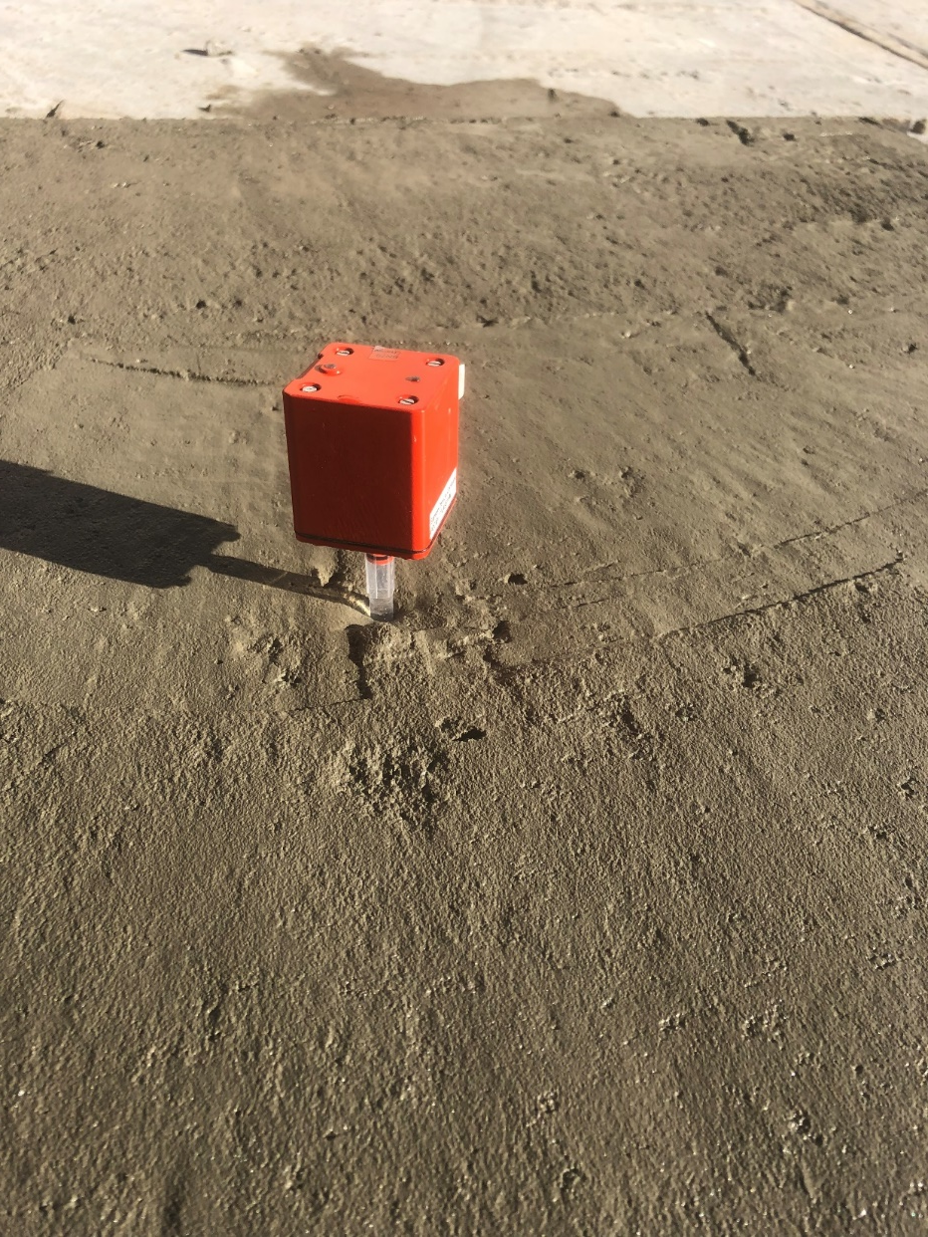
Trying to cause cracking
Notes:
Unsuccessful January Attempt

Slide 14

Trying to cause cracking
Warmer temperatures
Restraint
  No restraint = no stress

Slide 15
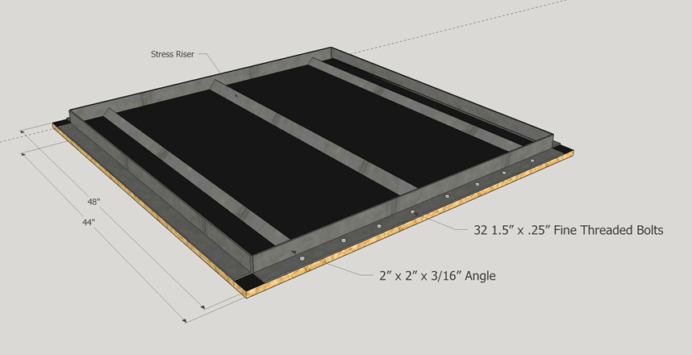
Formwork changes

Slide 16
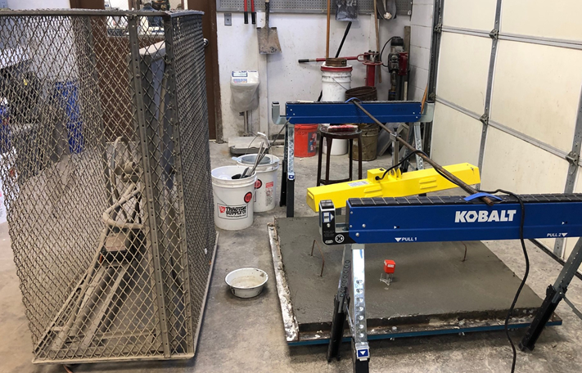
Next attempt

Slide 17
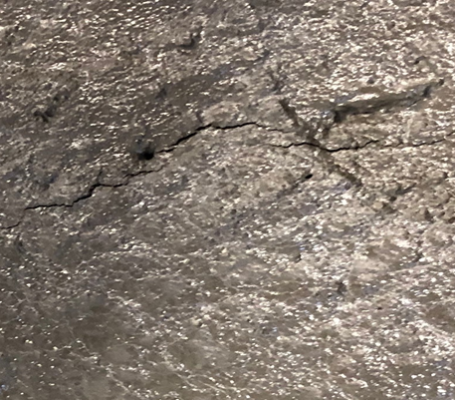
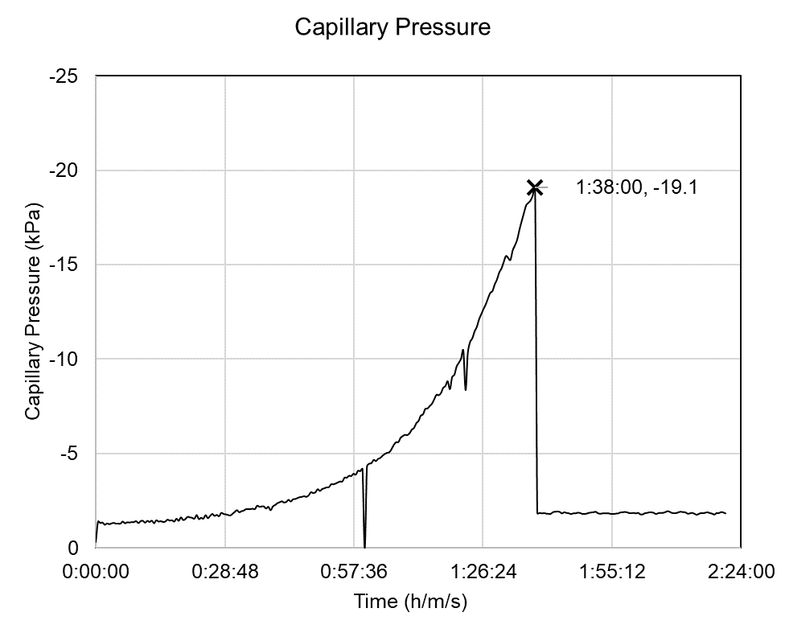
Next attempt – successful!

Slide 18
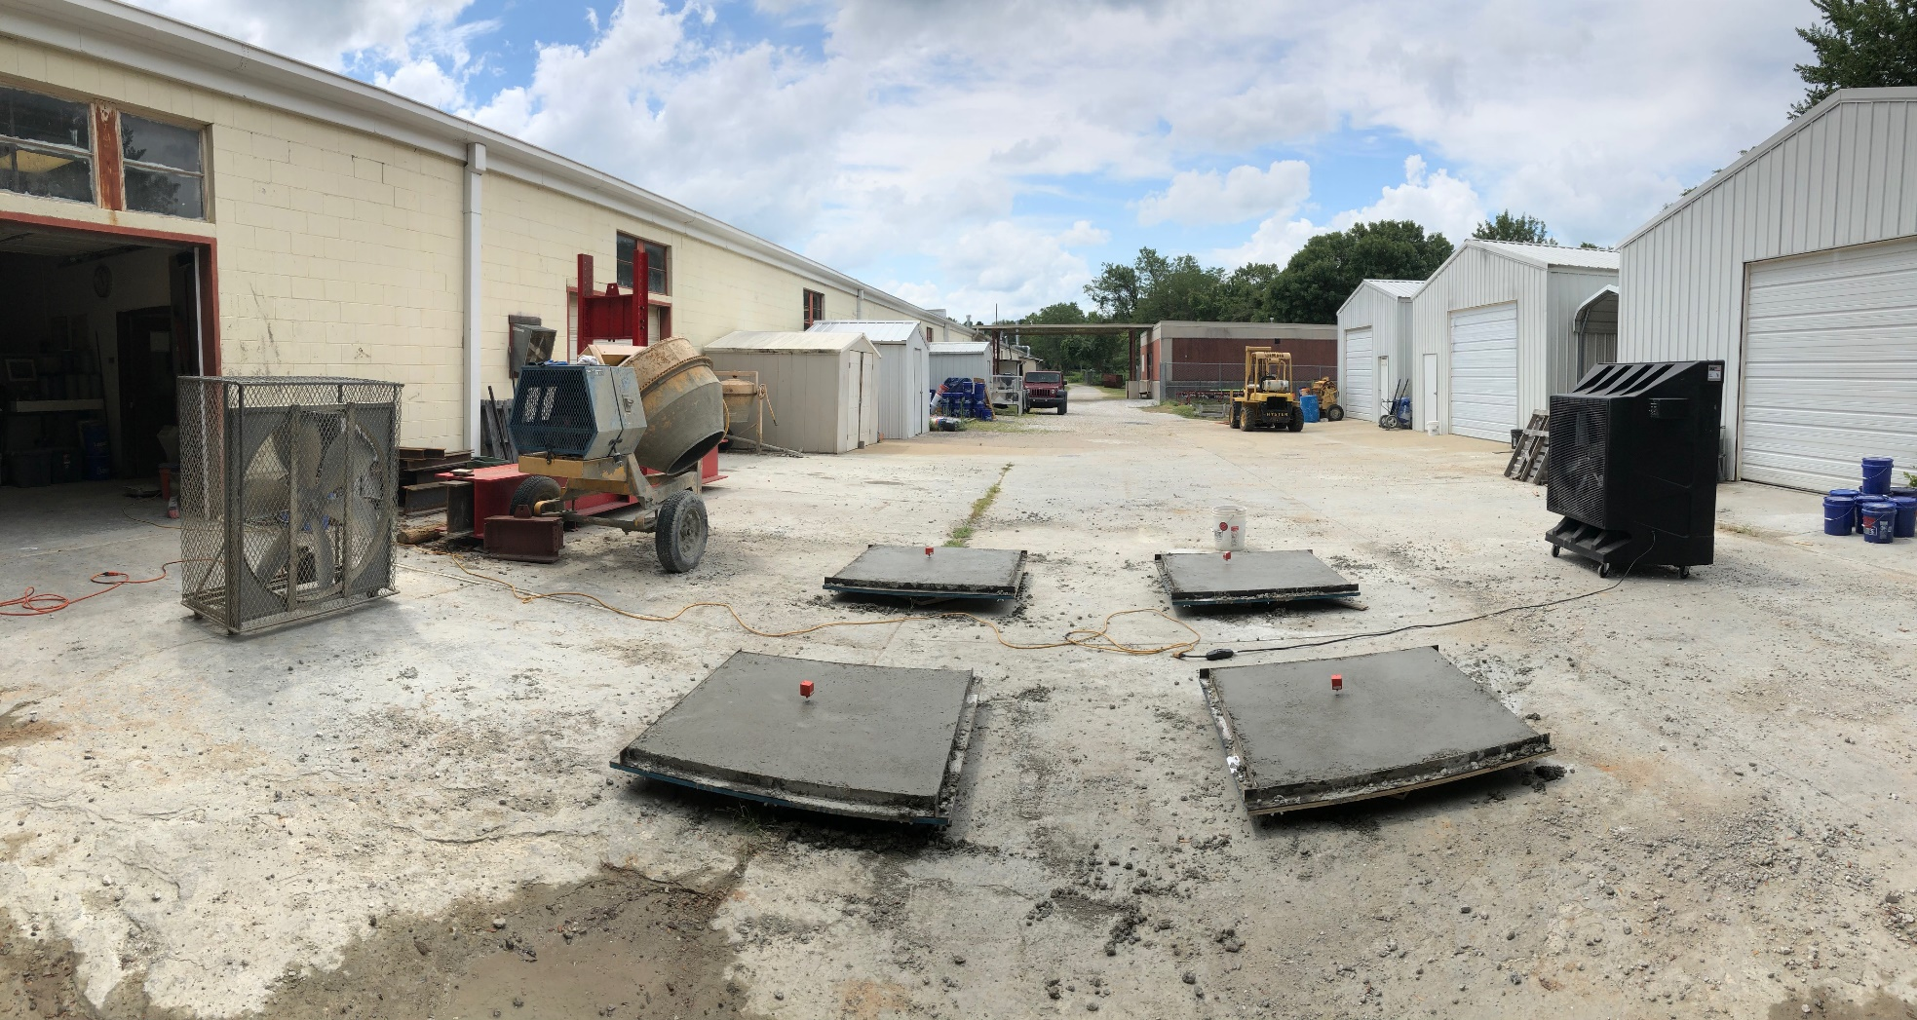
Current work

Slide 19
Current work
Wet burlap + plastic sheeting
Lithium based curing compound
Other compound (white or clear)
No curing

Slide 20
Curing methods
Selected from ARDOT QPL
  WR Meadows 1100 resin based, curing compound (clear)
  WR Meadows 1610 wax based curing compound (white)
  Sinak 1000 lithium cure
Other method
  Wet burlap + plastic sheeting

Slide 21
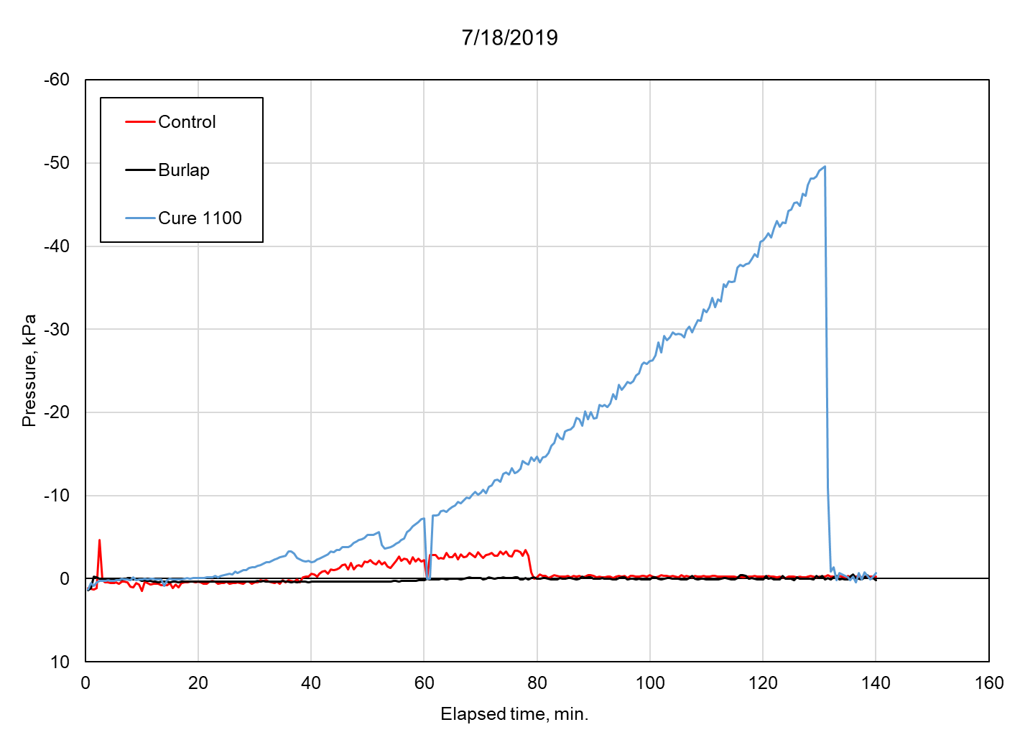

Slide 22
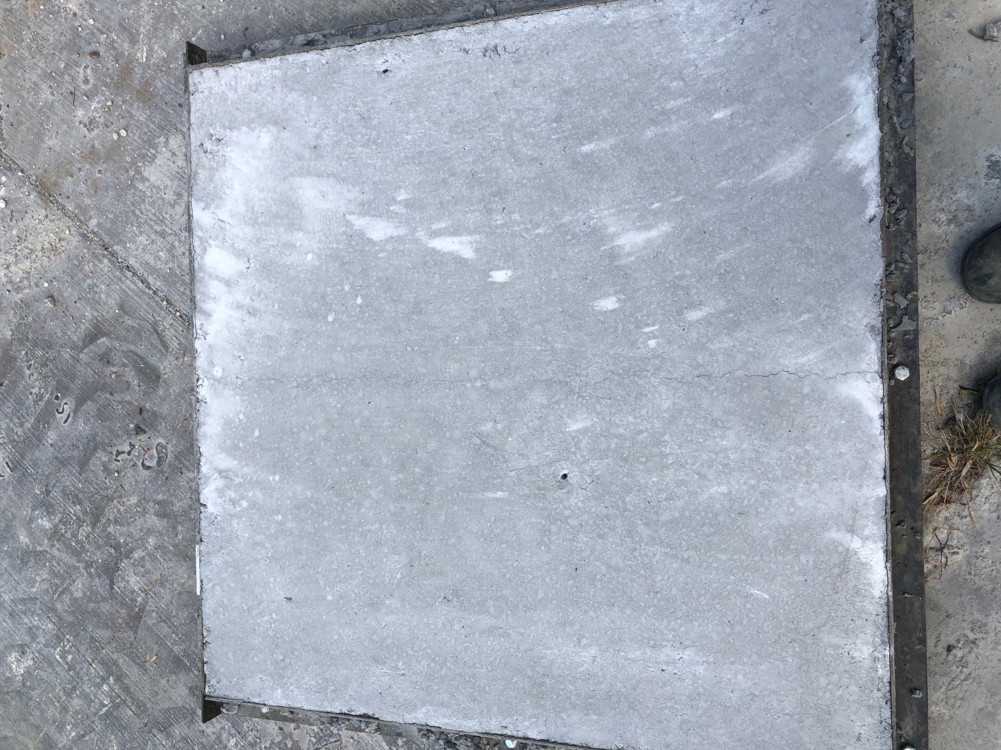

Slide 24
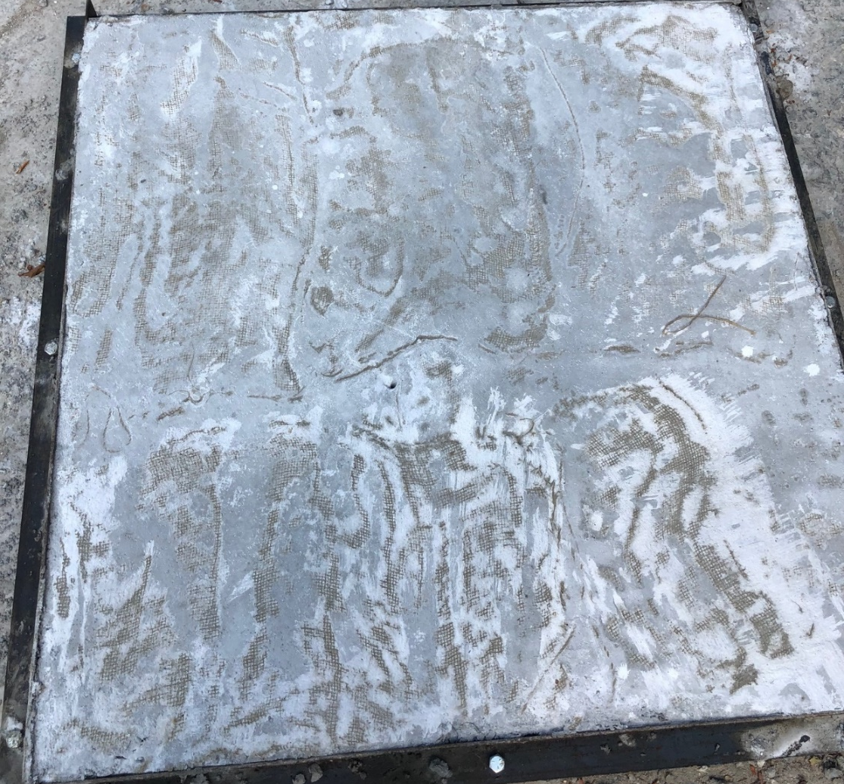

Slide 25
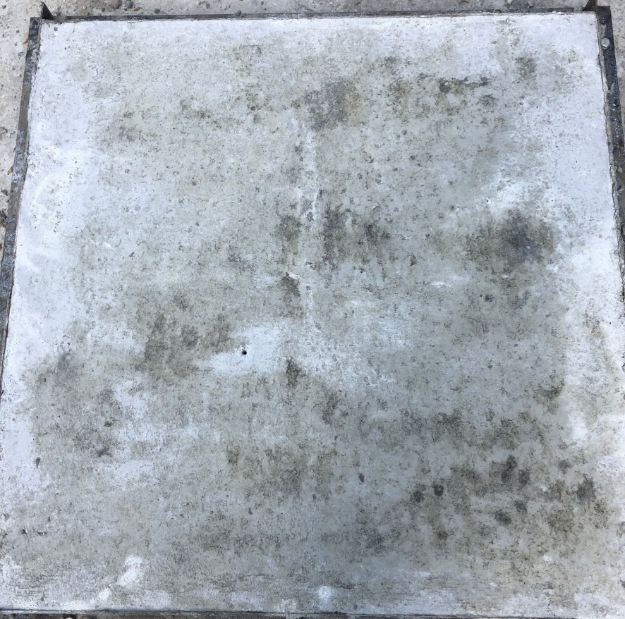

Slide 26
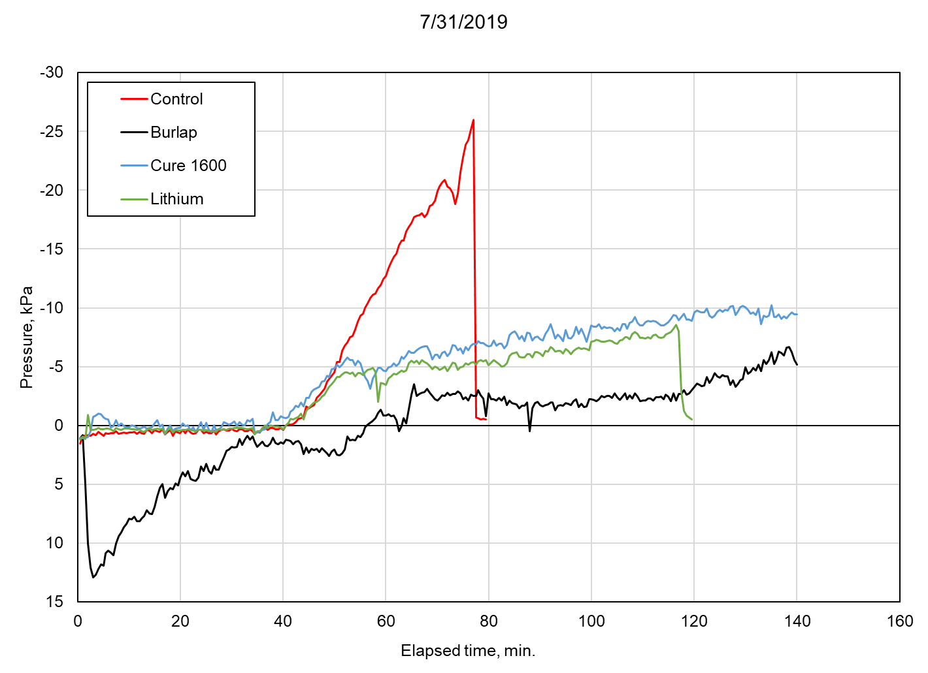

Slide 27
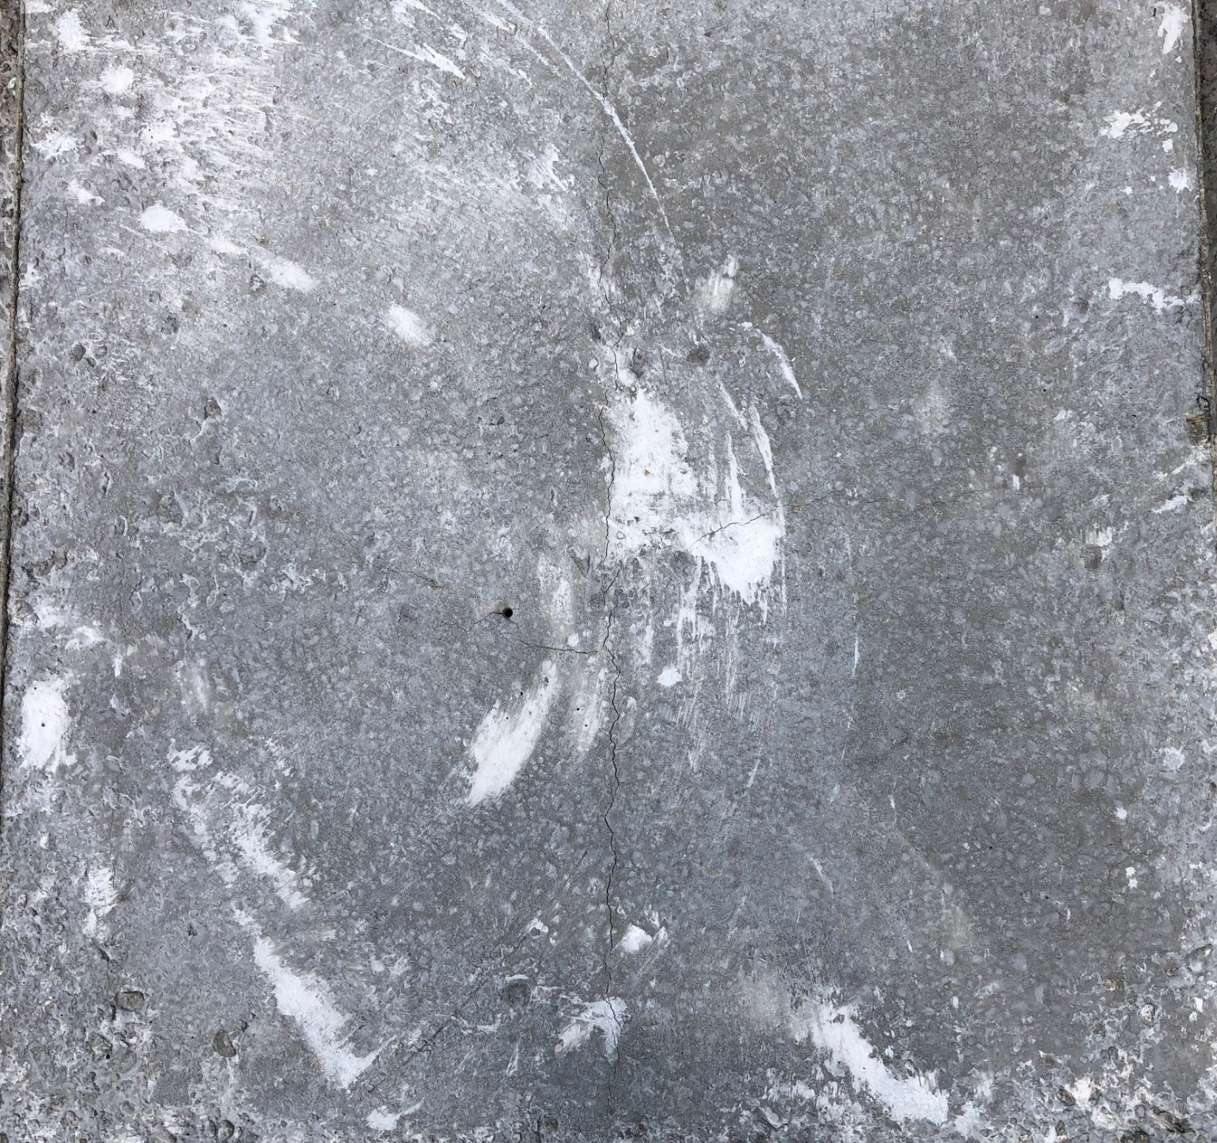

Slide 28
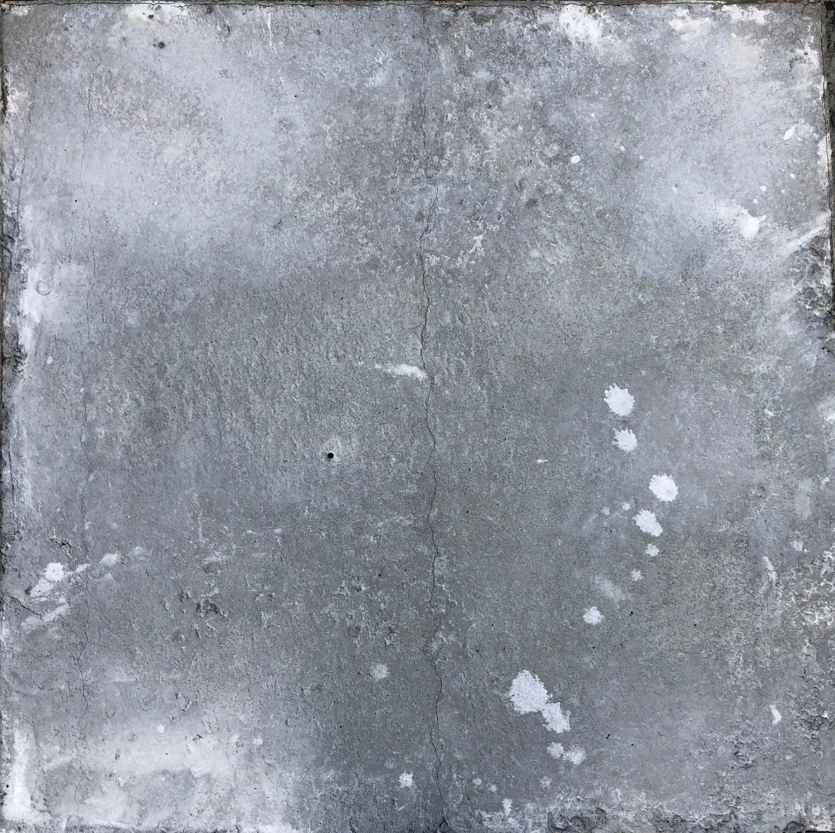

Slide 29
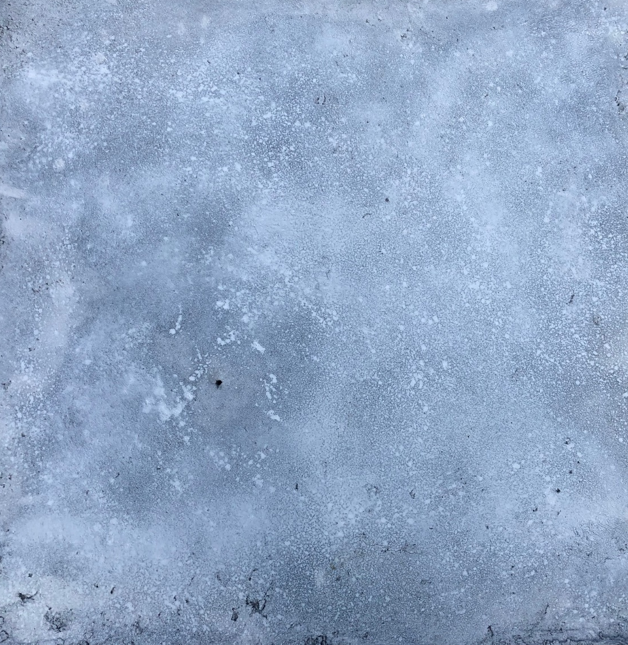

Slide 31
Anticipated results
Comparative study of the effectiveness of curing methods
  Data from VWSG and CPSS
Understanding of how to use CPSS
Field trials
Training for ARDOT

Slide 32
Questions?
Contact:
cdmurray@uark.edu

